Slide 1
A New Chapter
Douglas County Library 2028

Slide 2
Libraries are essential.
Outside of home and work, libraries are “third places” that anchor community life as part of our social infrastructure.
Unlike many third places, libraries are free and accessible to all.
Libraries are hubs for education and literacy, workforce development, and community connection.

Slide 3
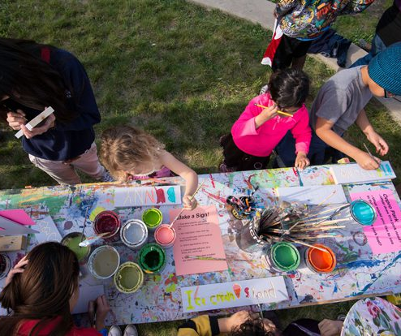
Residents rely on Douglas County Library.
"The staff at the library are always very helpful and friendly."
Patrons check out more than 336,000 materials per year on average.
Hundreds of programs serve an average of nearly 6,000 people each year.
Douglas County Library (DCL) sees more than 200,000 visits each year.
DCL is the only library serving residents of Alexandria, Brandon, Carlos, Evansville, Forada, Garfield, Holmes City, Kensington, Miltona, Nelson, Osakis, and other Douglas County communities.
"Every time we go it seems like new and creative items are added (like the adult activity bags – how neat is that!?)"

Slide 4
We listened to our community.
A 2021 Community Needs Assessment:
engaged residents, including 599 survey respondents, 28 focus group participants, and 34 one-on-one interviewees
included extensive research on current facility, industry standards, and peer libraries
Did you know?
Douglas County is among the 21 (of 87) counties in the State of Minnesota where residents are served by just one brick-and-mortar, full-service library facility. Within that subset, it is one of the largest counties by population.

Slide 5
The result: our building cannot meet community needs.
The current space cannot hold the large collection, provide enough room for programs, or comfortably accommodate all patrons.
Douglas County is growing. More residents = more demand for services.
The landlocked building cannot effectively be expanded or renovated to meet the diverse and growing needs of our community.
Current Library:
19,900 SF
Recommended Library Size for DCL Population:
34,000 SF
"I think the library outgrew the space a very long time ago. Staff has done well getting as much in as possible, but there is no room for growth."

Slide 6
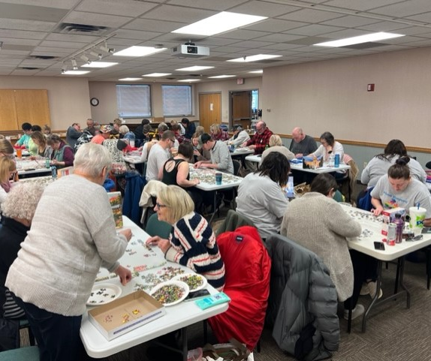
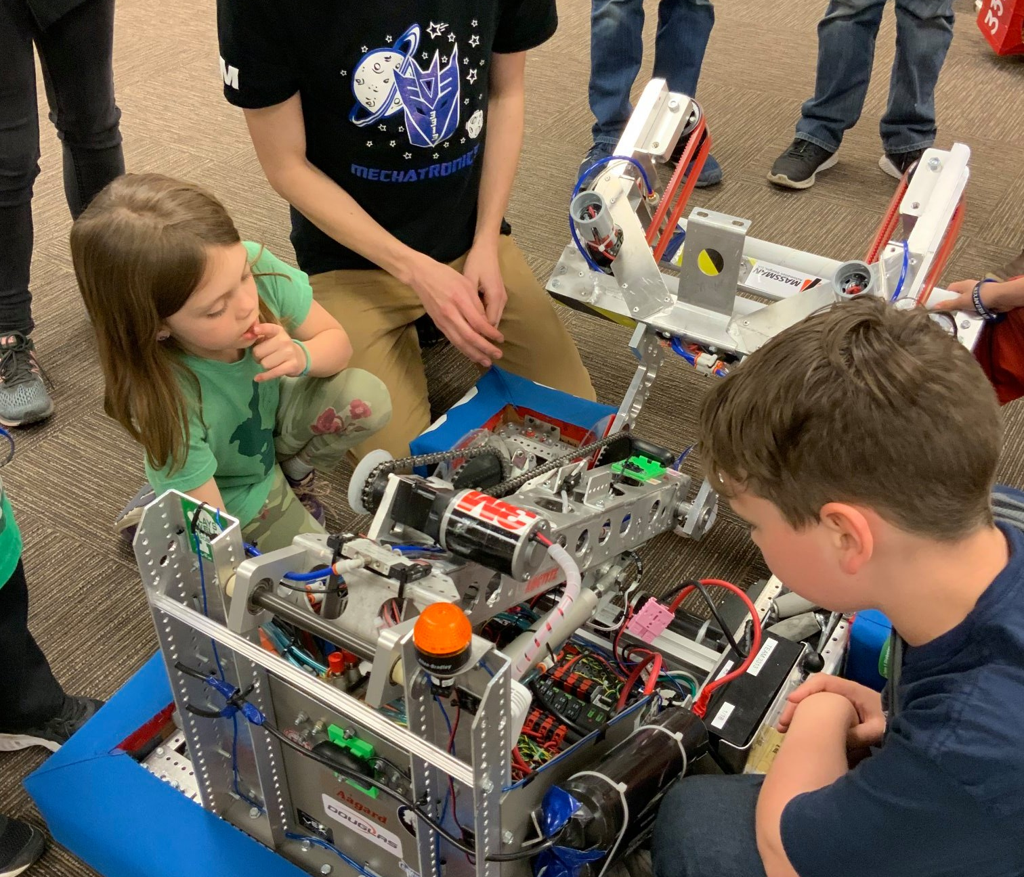
Our county needs a new library.
The Steering Committee formed as part of the Needs Assessment determined a new building is necessary. A new library will offer our residents better:
Accessibility
Visibility, ample parking, one-story space
Flexibility
Room for various programs, community meetings, quiet and loud activities
Connection
More opportunities for residents across county to connect to resources, information, and each other

Slide 7
With a new building, our Library can:
Partner with more community organizations to offer programming
Offer more flexible spaces for meeting, gathering, learning, and studying
Provide today's technology and plan for the technology of tomorrow
Respond to evolving community needs now, and in the future
Between 2011-2021, DCL offered an average of 141 children’s programs a year and averaged 4,923 participants per year
“The children's collection is amazing, and I know it could be even more amazing with more space and funding. It would be great if there could be more of a designated space for teens separate from the children's area, too. And a designated storytime area would be fun.”

Slide 8
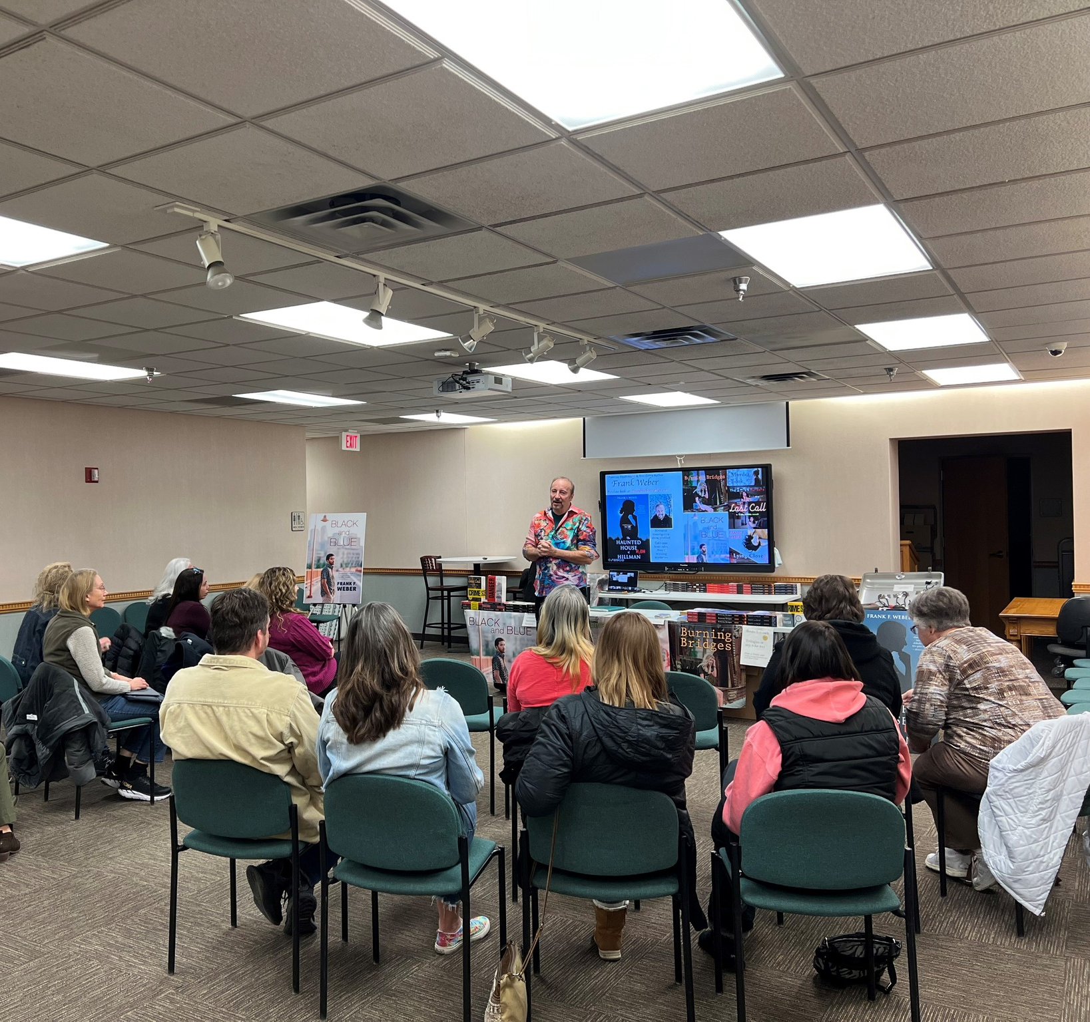
Overview of possibilities
The Douglas County Library Steering Committee has extensively researched the surrounding area, reviewing and evaluating 17 different sites.
Of those, three sites have been identified that can accommodate our community's and library's needs.
Each site offers at least six acres and is within a two-mile radius of downtown Alexandria and the current library.

Slide 9
Overview of investment
Proposed Building: 34,000 SF
Construction Estimate: $15 - $17 million
Notes:
Construction estimate includes hard costs and contractor OHP, furniture, fixtures, and shelving, professional fees, contingency at 9% of project budget
Estimate assumes 4% inflation over 4.5 years Construction begins spring of 2027
Land costs are not included
Staffing will need to increase by 1.5 FTE

Slide 10
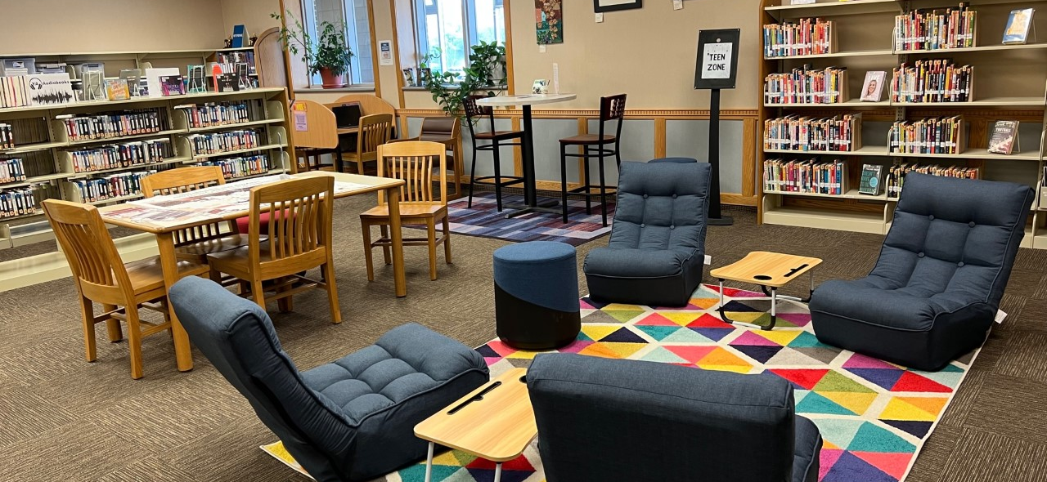
A new library is an investment in our future.
Our Library contributes to every aspect of quality of life in Douglas County.
With a new building, residents will have a welcoming space with more resources that can serve as a community hub for years to come.

Slide 11
Next Steps
1.
Land acquisition
Determine cost sharing structure between County, Library, and Friends of the Library.
Solidify site selection team comprised of County and Library representation.
2.
Form a capital campaign framework
3.
Explore supplementary funds such as grants
4.
Lay groundwork for voter referendum

